Slide 1


End Term Presentation for Course Project in IE506
Title: Density Estimators for Positive-Unlabeled Learning
Team: The Finishers
Rishabh Agnihotri (22N0456) | Shyam Agrawal (22N0461)
Instructor: Prof. P. Balamurugan
IEOR, IIT Bombay

Slide 2
Outline
Problem Statement
Before the Mid Term
Comments of Mid Term Review
Addressing Comments
After Mid Term
Summary
Conclusion
Possible Future Direction
Reference

Slide 3
Problem Statement
To improve classification performance in positive-unlabeled learning scenarios through better density estimation.
Train a binary classifier solely based on positively labeled and unlabeled data.
Obtaining ground truth labels is expensive and time-consuming.
Fraud detection, spam filtering, and anomaly detection.

Slide 4
Before the Mid Term
Understands the paper well and implement the code for some of the dataset given in paper.
Computational Framework:
The model was programmed in 80% Python and 20% R Programming Language.
For code implementation we use GoogleColab ran it for three datasets.
Author’s code have some issues regarding data-reading which was resolve by importing some libraries like liac-arff, bnlearn, tarfile.

Slide 5
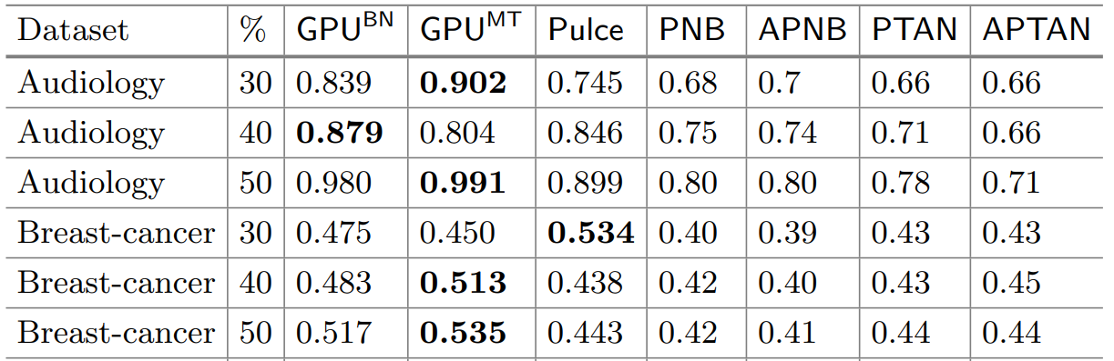
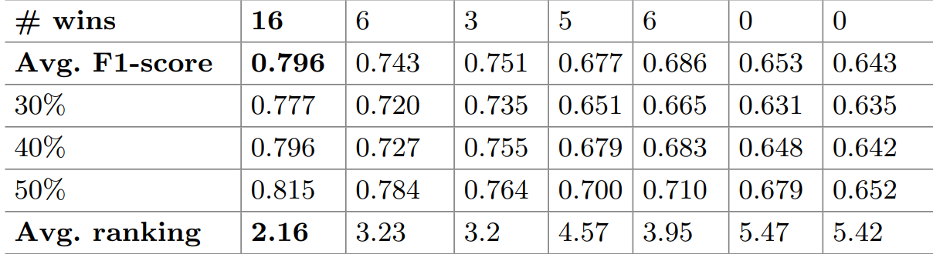
Before the Mid Term (Obtained Results)
The two GPU approaches won 73.3% of the times.
And 53.3% of the times GPUBN alone.
F1-SCORE (Accuracy)
F = 2PR/(P+R)
= 2tp/(2tp+fp+fn)
where, P and R are is the precision and the recall,
and tp, fp and fn are true positive, false positive
and false negative sample respectively.

Slide 6
Comments of Mid Term Review
Try to run the code for the rest of the datasets.
Try different ratio on positive samples.
Try some threshold for reliable negative samples.
Try to implement Random Forest classifier instead of SVM with RBF kernel on dataset given in paper.
Use MNIST dataset and then implement the code using Random Forest classifier.

Slide 7
Addressing the Comments
Time spent to run the code for almost all the datasets.
Ran the code for all datasets given in paper using Random Forest.
Using MNIST data implement the code.

Slide 8
Addressing the Comments (contd…)
Change threshold for negative samples but threshold was not consider in the code.
The datasets was given in the paper is already pre-processed into different ratio so we unable to change the ratios.
Partially implemented the code for MNIST data.

Slide 9
After the Mid Term
Run the code for almost all of the dataset that was not run before midsem.
Observe the results.
Initially the code was run by using SVM but now also we run it by using different classifier named Random Forest.

Slide 10
This is our result of the code by SVM classifier:
After the Mid Term (contd…)
Dataset | 30 % pos |  |  | 40 % pos |  |  | 50 %pos
 | #pos | Ones | F1-Score | #pos | Ones | F1-Score | #pos | Ones | F1-Score
Audiology | 15 | 2.6 | 0.8388 | 20 | 2.3 | 0.8789 | 26 | 2.8 | 0.9798
Breast-cancer | 54 | 25.7 | 0.4755 | 72 | 33.3 | 0.4828 | 91 | 38.8 | 0.5166
Chess | 451 | 148.6 | 0.6894 | 601 | 162.4 | 0.6911 | 751 | 159.7 | 0.7731
Hepatitis | 9 | 1.7 | 0.7096 | 12 | 0.7188 | 0.6598 | 15 | 1.7 | 0.6984
Nursery | 1166 | 0 | 0.7600 | 1555 | 0.0 | 0.8424 | 1944 | 50.4 | 1.0
Soybean | 25 | 3.4 | 0.9064 | 33 | 4.9 | 0.9007 | 42 | 4.4 | 0.8988
Vote | 72 | 22.9 | 0.8325 | 96 | 21.0 | 0.8621 | 120 | 27.9 | 0.8828

Slide 11
This is our result of the code by Random Forest classifier:
After the Mid Term (contd…)
Dataset | 30 % pos |  |  | 40 % pos |  |  | 50 %pos
 | #pos | Ones | F1-Score | #pos | Ones | F1-Score | #pos | Ones | F1-Score
Audiology | 15 | 2.6 | 0.8272 | 20 | 2.3 | 0.9808 | 26 | 2.8 | 1.0
Breast-cancer | 54 | 25.7 | 0.5943 | 72 | 33.3 | 0.6282 | 91 | 38.8 | 0.6282
Chess | 451 | 148.6 | 0.6227 | 601 | 162.4 | 0.6975 | 751 | 159.7 | 0.7810
Hepatitis | 9 | 1.7 | 0.5825 | 12 | 0.0 | 0.6598 | 15 | 1.7 | 0.6367
Nursery | 1166 | 0 | 0.7099 | 1555 | 0.0 | 0.8448 | 1944 | 50.4 | 0.9989
Soybean | 25 | 3.4 | 0.7817 | 33 | 4.9 | 0.8323 | 42 | 4.4 | 0.8879
Vote | 72 | 22.9 | 0.8810 | 96 | 21.0 | 0.8854 | 120 | 27.9 | 0.8826

Slide 12
After the Mid Term (contd…)
Import the MNIST data using sklearn (fetch_openml)
Pre-process the MNIST data.
Try to implement code using MNIST data but partially succeed for the same.

Slide 13
After the Mid Term (contd…)
Computational Framework
The model was programmed in 80% Python and 20% R Programming Language for both the datasets.
For code implementation, Google Colab was taking too much time after that we move to IEOR server.
Contribution of Team Member
Both members have implemented code together and understand in well manner.
For entire project both team members contributed in equal ratio.

Slide 14
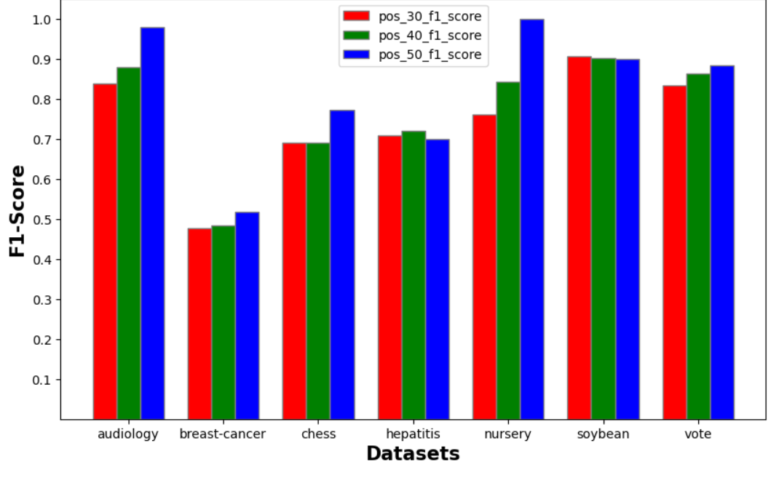
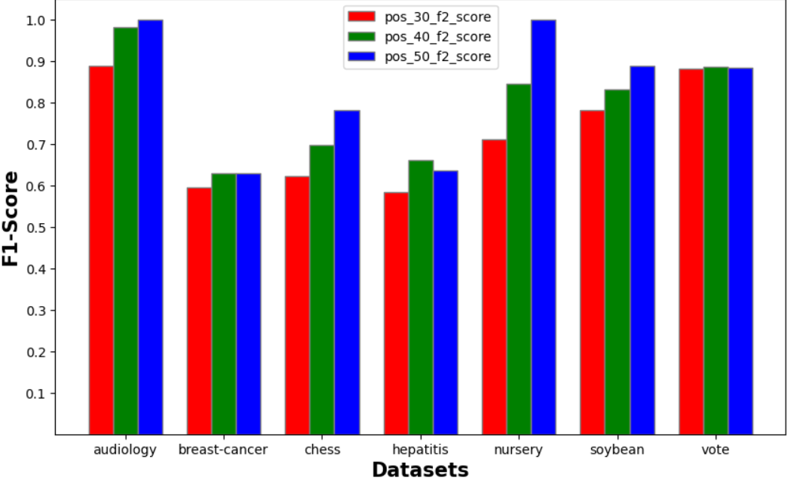
Observation
Accuracy by SVM with RBF kernel
Accuracy by Random Forest

Slide 15
Summary
PU learning considers a set of positive samples and a larger set of unlabeled samples.
GPU acceleration can be used to speed up the density estimation process.
The framework is flexible and can be applied to many domains.
We observe the results for different datasets using classifier SVM with RBF kernel and Random forest.
Results on several benchmark datasets show the performance and flexibility of the proposed approach.

Slide 16
Conclusion
This paper presents a density estimator for PU learning that leverages the power of GPUs to extract reliable negative samples.
The use of GPU for negative sample selection enables the method to extract reliable negative samples with high precision, resulting in improved performance.
The SVM with RBF kernel-based density estimation approach is able to effectively estimate the underlying positive distribution and classify new samples as positive.
Random Forest-based density estimators provide a promising approach for addressing the challenges of density estimation in PU learning and have shown to be effective in practice.
Worked on both the paper’s data and mnist data but find satisfactory result for paper’s data.

Slide 17
Possible Future Direction
As Given in Paper
Further research is needed to investigate the full potential of the proposed method and to explore its applicability to other related tasks.
To investigate how to adapt GPU learning to more complex learning settings.

Slide 18
Reference
Basile, T., Mauro, N.D., Esposito, F., Ferilli, S., Vergari, A.: Generative probabilistic models for positive-unlabeled learning. In: Workshop on NFMCP Held with ECML/PKDD (2017)
Calvo, B., Larraaga, P., Lozano, J.A.: Learning bayesian classifiers from positive and unlabeled examples. Pattern Recogn. Lett. 28(16), 2375–2384 (2007)
Ienco, D., Pensa, R.G.: Positive and unlabeled learning in categorical data. Neuro-computing 196, 113–124 (2016)
Lowd, D., Rooshenas, A.: The Libra toolkit for probabilistic models. CoRR abs /1504. 00110 (2015)
Sch¨olkopf, B., Platt, J.C., Shawe-Taylor, J.C., Smola, A.J., Williamson, R.C.: Estimating the support of a high-dimensional distribution. Neural Comput. 13(7), 1443–1471 (2001)
Zhou, K., Gui-Rong, X., Yang, Q., Yu, Y.: Learning with positive and unlabeled examples using topic-sensitive PLSA. TKDE 22(1), 46–58 (2010)
import mnist_784 data from sklearn.datasets import fetch_openml
http://archive.ics.uci.edu/ml/

Slide 19
Thank You

